Slide 1

TRƯỜNG ĐẠI HỌC KHOA HỌC TỰ NHIÊN - ĐHQG TPHCM
KHOA CÔNG NGHỆ THÔNG TIN
FACTORY METHOD
LẬP TRÌNH HƯỚNG ĐỐI TƯỢNG - Nhóm OOP For Life

Slide 2
5G in a nutshell
List the topics covered in the presentation
5G 101
5G: Then and now
Mobile Networks and 5G Technology
A primer on 5G Technology
5G Technology Adoption in the World
Benefits of 5G Technology

Slide 3
5G Technology in a nutshell
5G is the fifth generation of wireless technology that boasts way more than just faster speeds. It uses higher frequency bands to support quick connection, less latency, and more devices.

Slide 4
Before 5G Technology
With 5G Technology
The fastest speed is 200 Mbps
The fastest speed can go beyond 1 Gbps.
Latency is 20 to 30 milliseconds
Latency is less than ten milliseconds
Channel bandwidth is up to 20 MHz
Channel bandwidth is up to 500 MHz

Slide 5
1G
1980S
Analog cell phones allow people to talk to each other
2G
1990S
Voice service, SMS, and MMS
Mobile
Networks and
5G Technology
Voice with data, SMS, MMS, video calls, Internet access, mobile TV
3G
2000S
Voice with data, SMS, MMS, Internet access, video calls, mobile TV HD, cloud computing
4G
2010S
Voice with data, SMS, MMS, Internet access, video calls, mobile TV HD, cloud computing, and the Internet of Things
5G
CURRENT

Slide 6
30
5G Technology Adoption in
the World
20
10
As of January 2021
5G technology adoption continues to rise in more countries and cities.
0
Item 1
Item 2
Item 3
Item 4

Slide 7

Is 5G better than LTE?
Understanding network speeds
The future lies in 5G. As opposed to LTE that only uses lower frequency bands, 5G runs on a higher frequency, providing users with a larger bandwidth.

Slide 8

The Benefits
of 5G Technology

Slide 9
ENHANCED AUTOMATION
Businesses can enjoy a more streamlined workflow thanks to 5G technology.
Benefits on Businesses
BIG DATA ANALYTICS
Companies will be better equipped when it comes to collecting, storing, and analyzing data.
Empowering small businesses
and enterprises
RICHER COMMUNICATION EXPERIENCES
Low latency means little to no lags, enabling genuine real-time reaction.

Slide 10
SMARTER HOMES AND CITIES
Expect better security, lighting, audio, and so much more.
Benefits of on Daily Life
DRIVERLESS CARS
Autonomous vehicles will be better capable of detecting danger, communicating with other cars, interacting with smart signs, and following maps.
Improving day to day
ENHANCED STREAMING AND ENTERTAINMENT
With unlimited capacity and short lags, everyone can enjoy faster and better quality streaming, immersive experiences, and multisensory content.

Slide 11

Does 5G technology really pose health risks?
How safe is 5G?
Experts have expressed that there are no factual bases for claims that say 5G poses risks to people's health though more studies on 5G can be valuable. Consumers also need to be educated more on how 5G works.

Slide 12
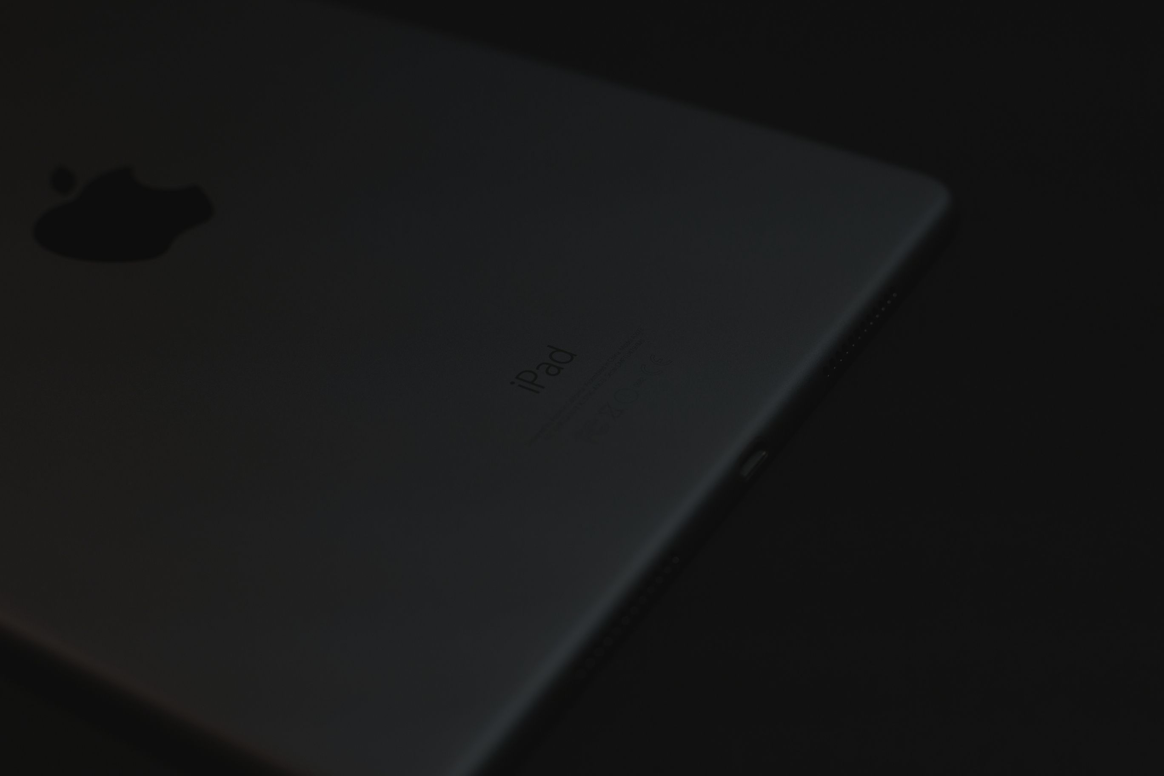
5G can change everything, but there needs to be a comprehensive information campaign for businesses and consumers.

Slide 13




Increased reliance on AI and machine learning
Cloud platforms
Trends and the Future of Telecommunications
Influx of IoT devices
Diversified ecosystems
Smart cities

Slide 14
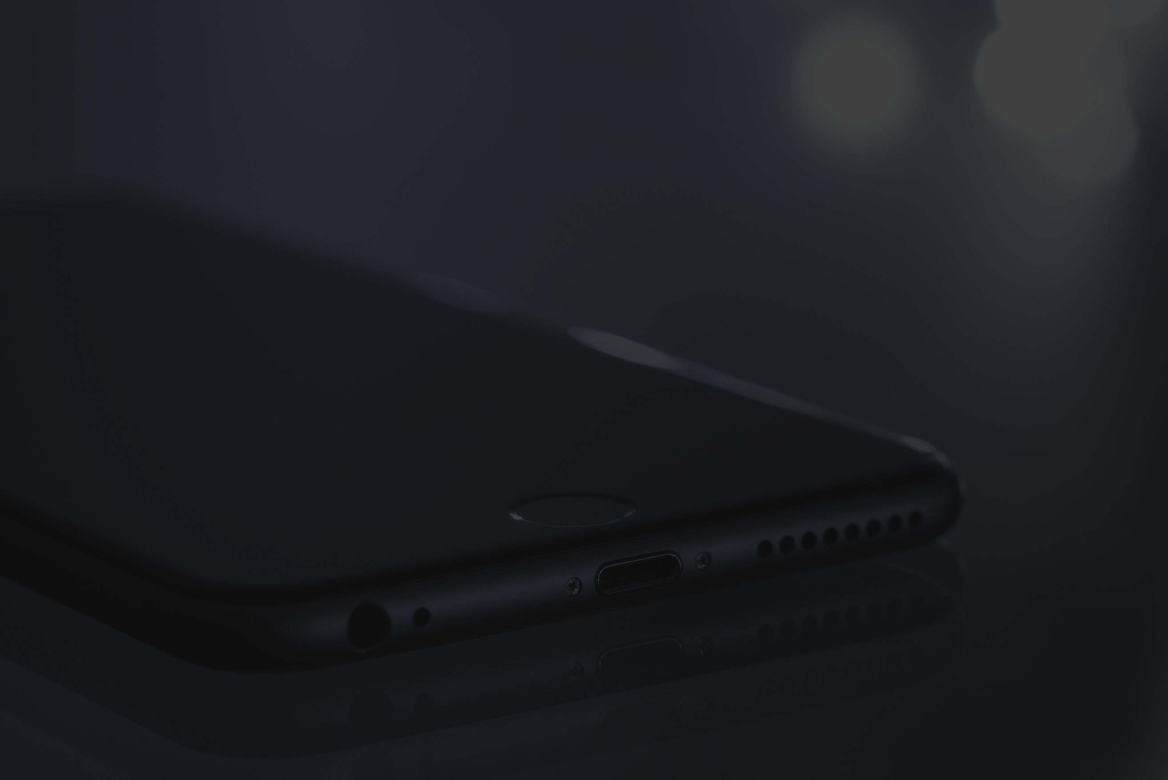
The network of the future is already being built as we speak. 5G is an important part of that.
EBEN ALBERTYN

Slide 15

Do you have
any questions?
Send it to us! We hope you learned something new.

Slide 16

















Free Resources
Send it to us! We hope you learned something new.

